Slide 1

Intro to GIS (Session 1)
Ki Tong
ktong2@ed.ac.uk

Slide 2
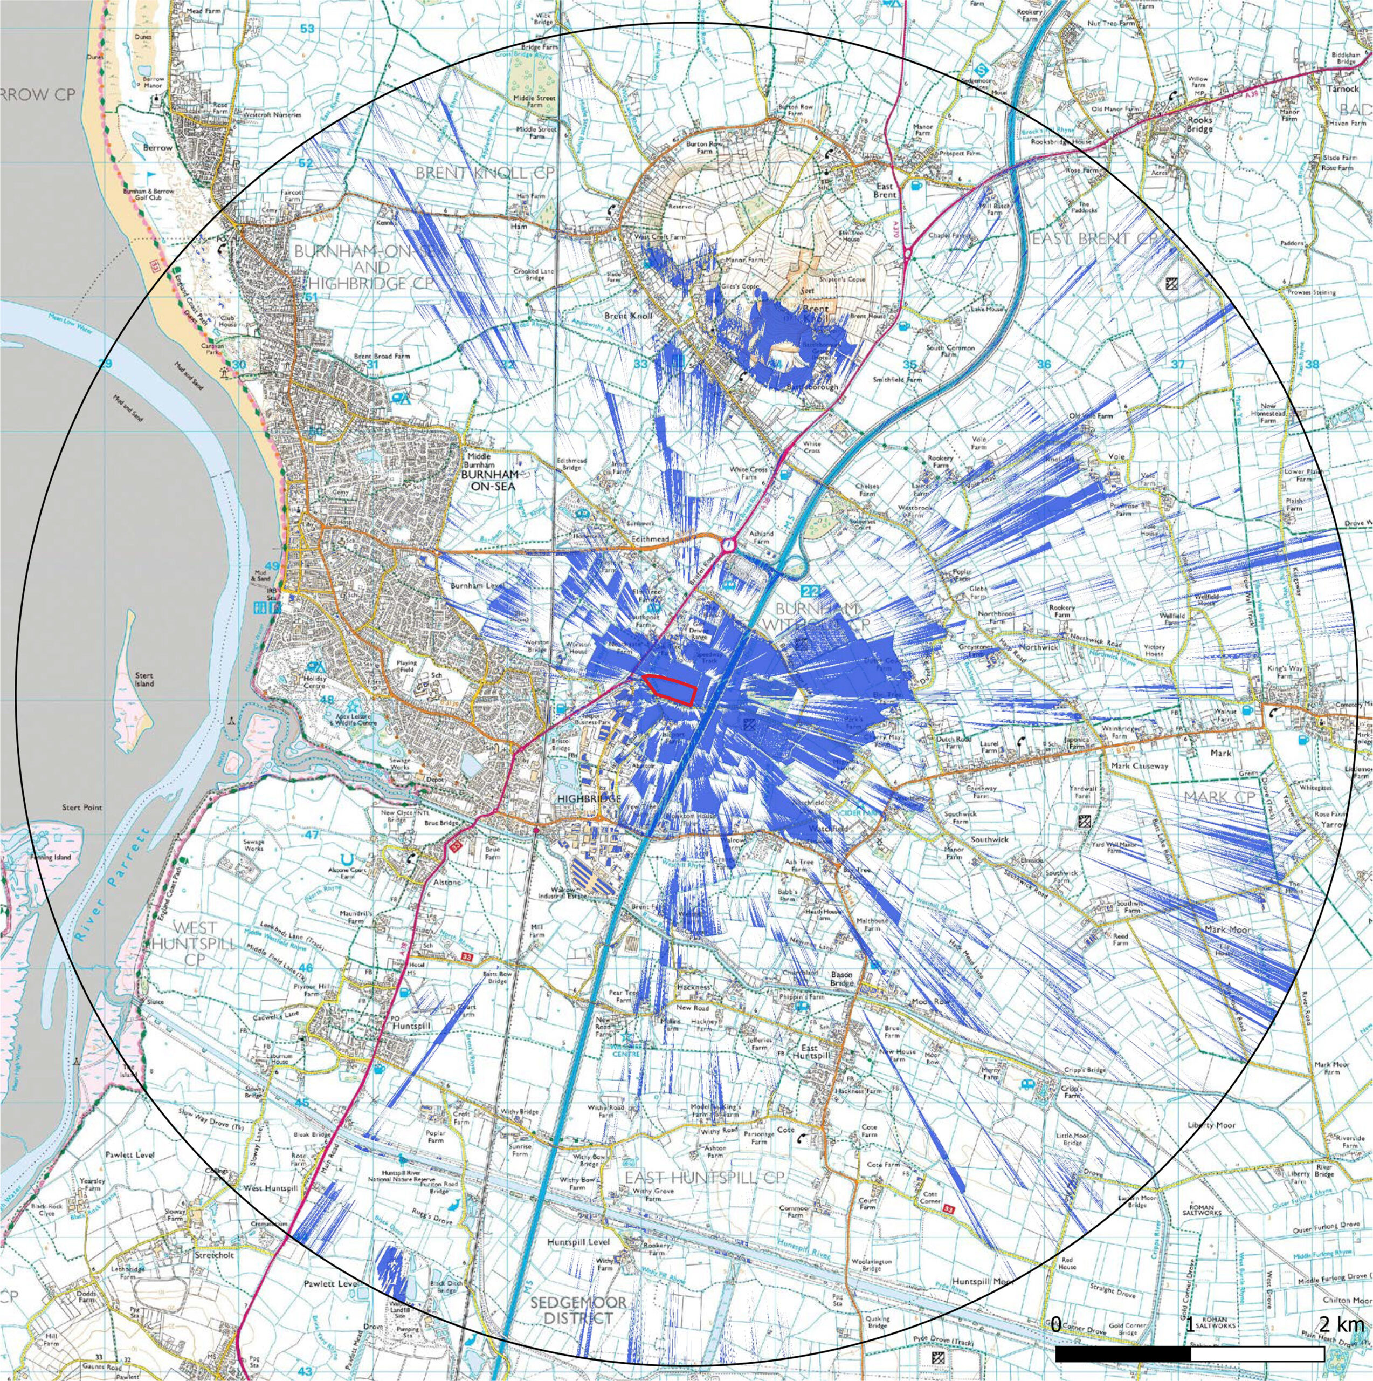
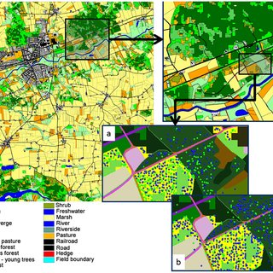

Before Starting…
Who am I
PhD candidate at the Advanced Care Research Centre, University of Edinburgh
Chartered Landscape Architect
- Landscape Visual Impact Assessment
- Landscape Planning Design
- Ecology Impact
Training Fellow with CDCS

Slide 3
Before Starting…
The Workshop
Two sessions
22nd Oct 2024, 10:00 – 12:00
The difference between vectors and rasters
Working with layers in QGIS
Projections and Coordinate Reference Systems (CRS)
Changing projections and the pitfalls of neglecting CRS
Importing vectors, rasters and delimited text layers
Spreadsheets, csv files and attributes/non-spatial data
29th Oct 2024, 10:00 – 12:00
Basic visualisation of geospatial data (2D and 3D)
Georeferencing vectors from non-geographic software (AutoCAD)
Exporting and organising geospatial data
Plugins and QGIS as opensource software
Creating new data, attributes and layers using the QGIS Processing Toolbox
Using the field calculator in QGIS
The print composer and exporting maps

Slide 4
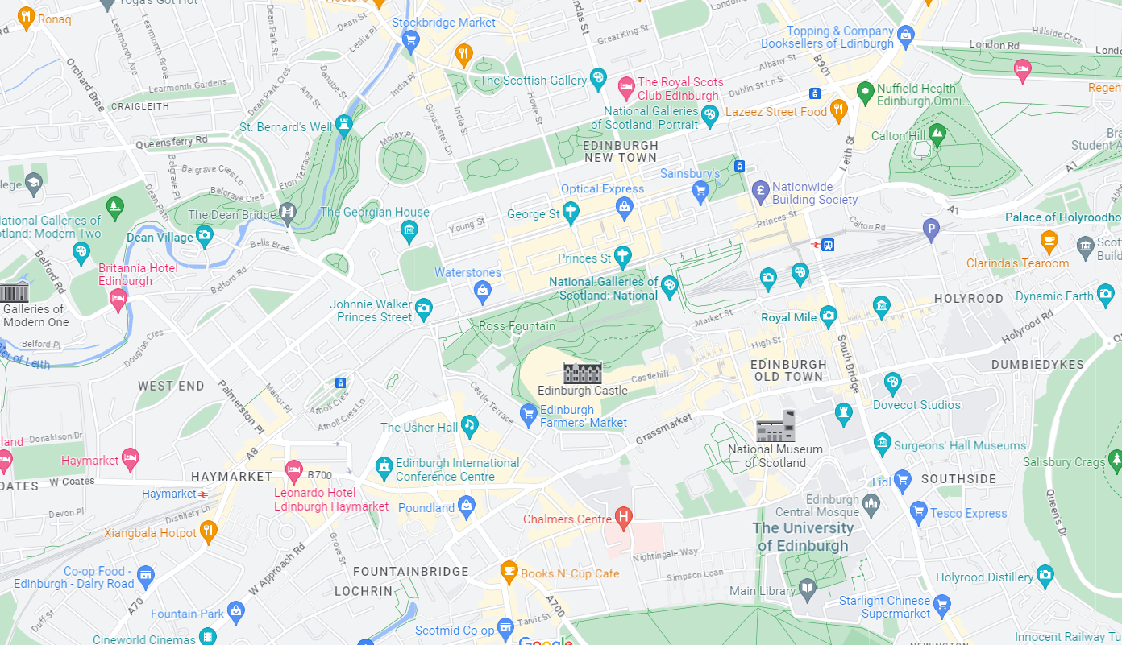
What is Geospatial Data? Vectors
Greenspace
(polygon)
Generalised representation of the real world
Points, lines or polygons
Normally in .shp (shapefile) format
Main library (point)
Railway line
(line)
https://www.safe.com/what-is/spatial-data/

Slide 5
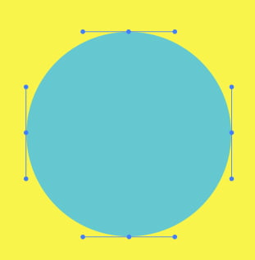
Vectors
Vectors are based on a grid of X, Y (and potentially Z) coordinates connected to an attribute table. They can store way more and more diversified information than a raster file and are geometrically more accurate than a pixel-based documentation. However, they lack in realistic details.
Compared to raster representations, vectors can be considered virtual objects located in a virtual 2D/3D space. That’s why the input data for 3D printing is a vector file, not a raster.

Slide 6
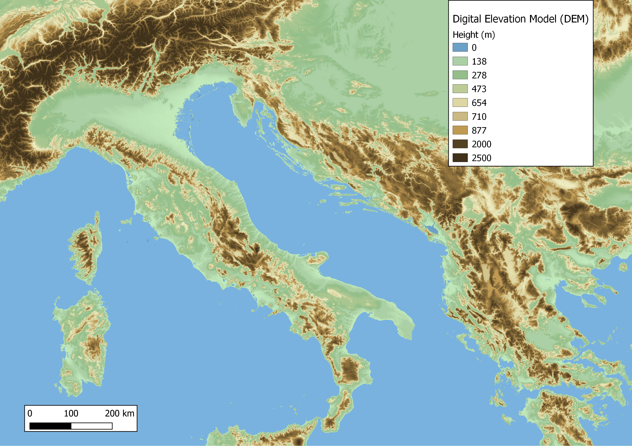
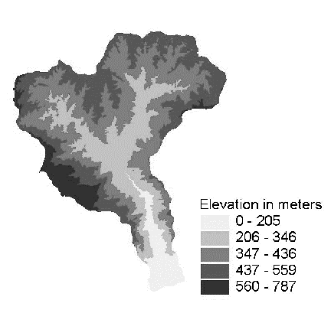
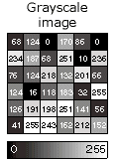
What is Geospatial Data? Rasters
Grid of pixels, each with a value
Quality depends on resolution of pixels
Various formats, normally .tif
https://www.safe.com/what-is/spatial-data/

Slide 7
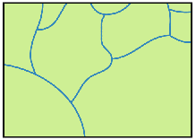
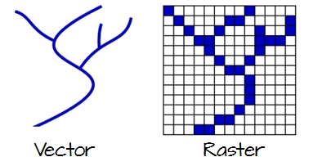
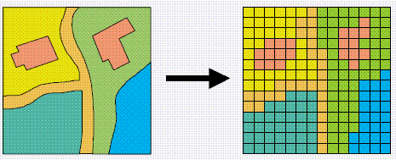
Quick question…
Is a river vector or raster?

Slide 8
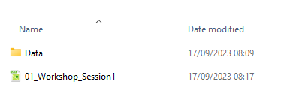
Let’s take a look at both data in QGIS
Go to folder
Make sure folder “data” is next in the same folder as 01_Workshop_Session1 like this…
Then double-click onto 01_Workshop_Session1 to open QGIS

Slide 9
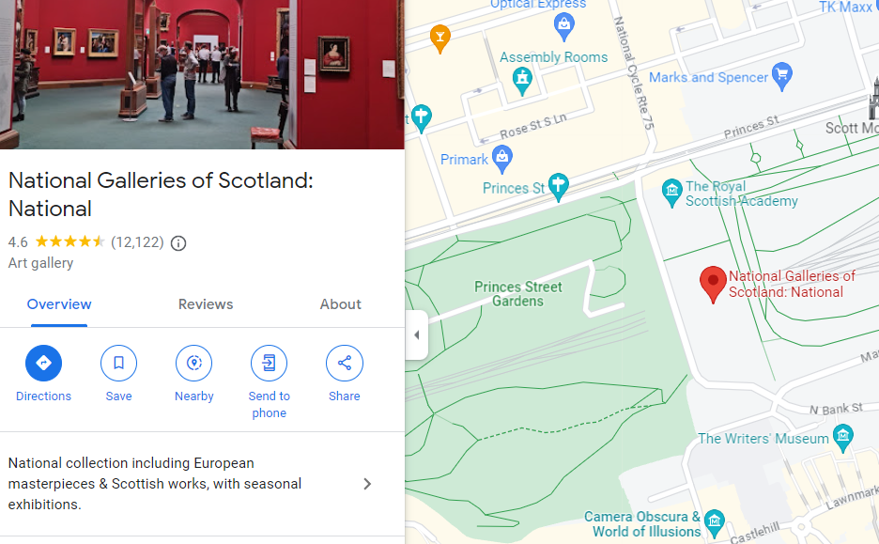
What is Geospatial Data? Attributes
Any non-spatial information that describes a feature
Place name | Review | Place category | Overview
National Galleries of Scotland | 4.6 | Art gallery | National collection including…
Primark | 4.8 | Retail | Reasonable clothes and homeware
Optical Express | 5.0 | Optician | Eye-check services
https://www.safe.com/what-is/spatial-data/

Slide 10
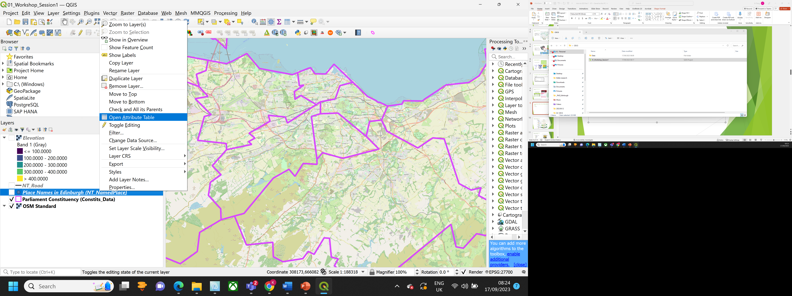
Let’s take a look at the attribute data in QGIS

Slide 11
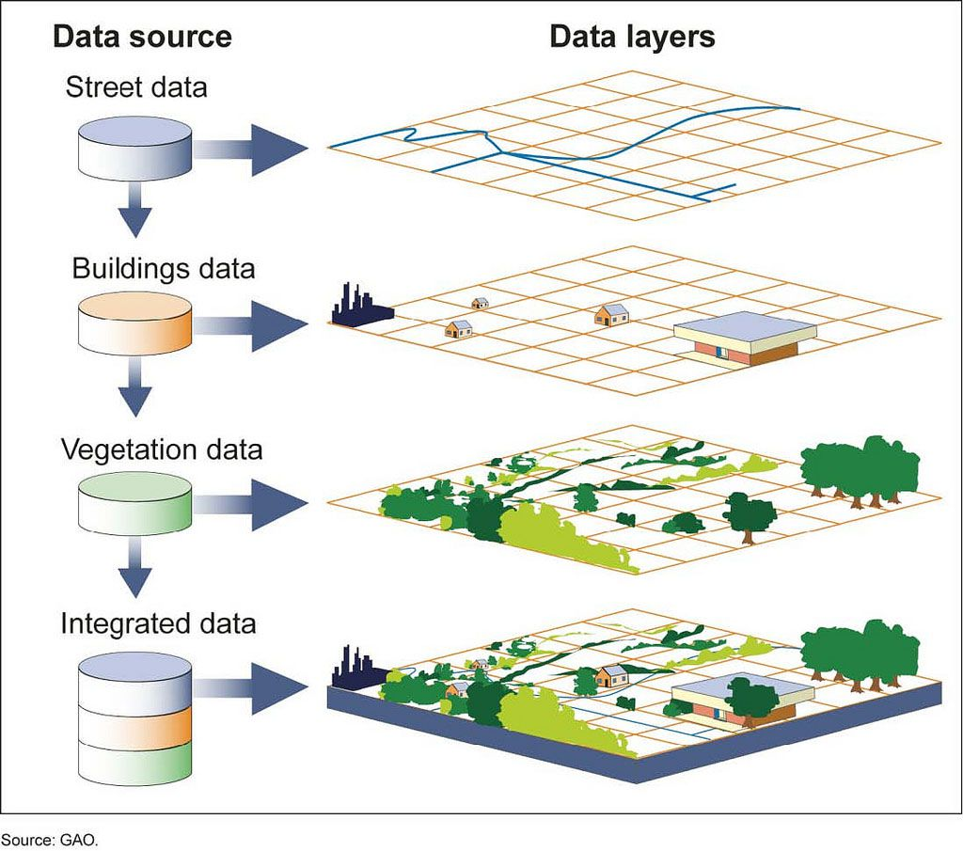
What is Geospatial Data? Working with layers

Slide 12
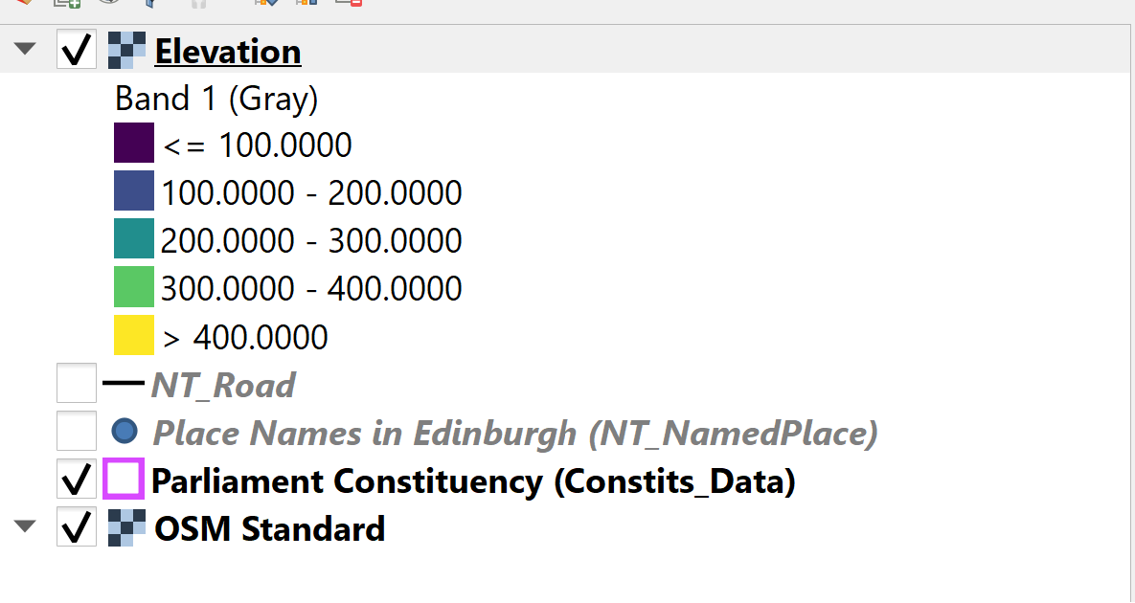
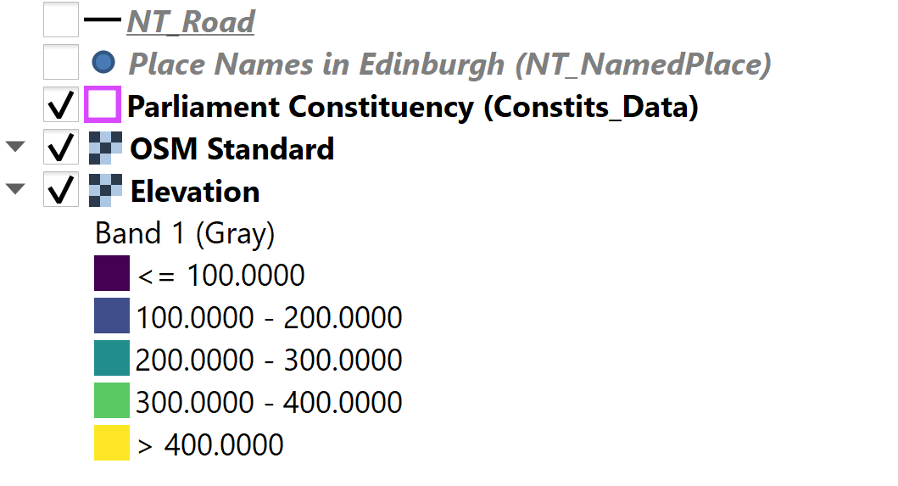
Let’s take a look at the attribute data in QGIS

Slide 13
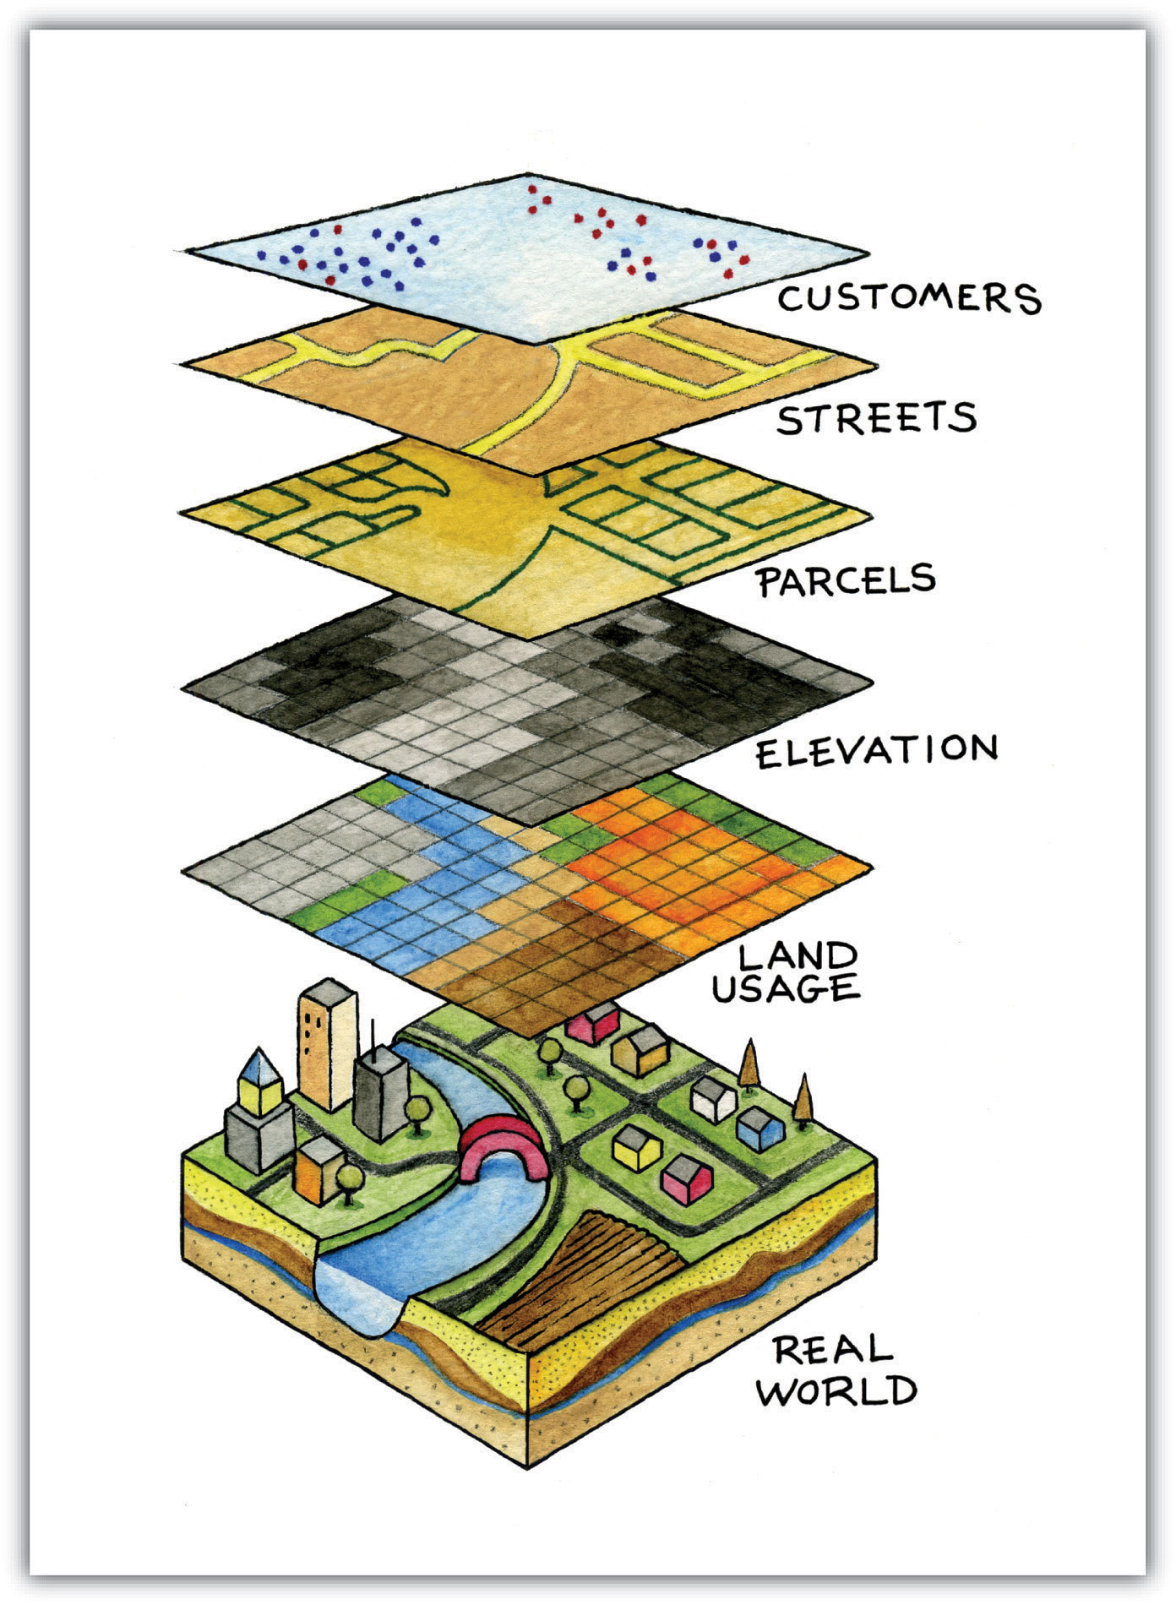
What is Geospatial Data? Working with layers
Layer types can include:
Shapefiles
GeoPackages
Spatialites
Rasters
Mesh
GPX
Layers will appear in the order they are placed in the Layers List.
Layers can be turned on/off.

Slide 14
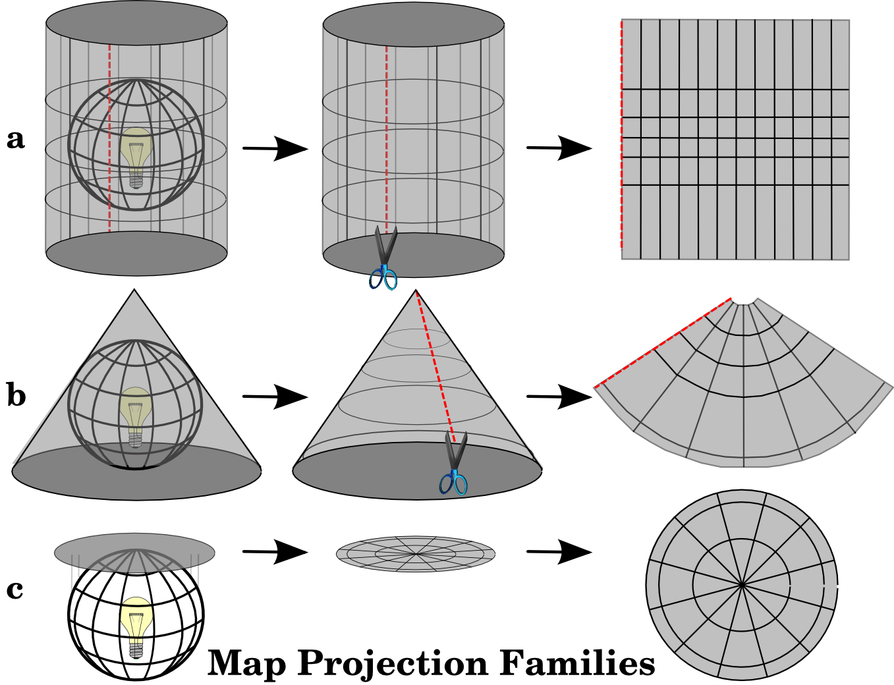
What is Geospatial Data? Projections and Coordinate Reference Systems (CRS)
Maps, whether physical or digital, generally portray a three dimensional space (the planet) on a 2 dimensional medium
CRS are the systems that, with the use of coordinates, define how the 3D data is projected onto the 2D output
https://docs.qgis.org/3.16/en/docs/gentle_gis_introduction/coordinate_reference_systems.html
https://www.youtube.com/watch?v=D3tdW9l1690
Notes:
The process of creating map projections is best illustrated by positioning a light source inside a transparent globe on which opaque earth features are placed. Then project the feature outlines onto a two-dimensional flat piece of paper. Different ways of projecting can be produced by surrounding the globe in a cylindrical fashion, as a cone, or even as a flat surface. Each of these methods produces what is called a map projection family. Therefore, there is a family of planar projections, a family of cylindrical projections, and another called conical projections

Slide 15
What is Geospatial Data? Projections
There are three main map projection families
A) Cylindrical
B) Conical
C) Planar
Each has advantages and disadvantages
None actually change the data itself, simply the way it is presented/projected
https://docs.qgis.org/3.16/en/docs/gentle_gis_introduction/coordinate_reference_systems.html
https://www.youtube.com/watch?v=D3tdW9l1690
Notes:
Azimuthal/Zenithal/Planar Projections:
Pros: These maps are useful for navigation if the map-reader knows how. Here are the facts. 1) distances from or through the map center are true; 2) directions from the map center to any other point are also held true. Any other measure of distance or direction will not be true.
Cons: If a literal projection is used, then these maps cannot show the whole earth. Typically these projections show about half of the earth at a time so they are not good for world maps.
Conical Projections:
Pros: These maps are very good for mapping regions that are primarily West-East in dimension like the United States. That is because a cone, when developed, is itself wider than tall.
Cons: The basic con is that a single cone cannot show the entire globe. They will typically show a little more than a hemisphere. Also, conic maps show only a sector of a complete circle…they don't develop into a complete circle.
Cylindrical Projections:
Pros: A cylinder wrapped around a globe will cover more of the globe than either a plane or cone can. This means that these tend to be best for world maps.
Cons: These still cannot show ALL of the earth's surface.

Slide 16
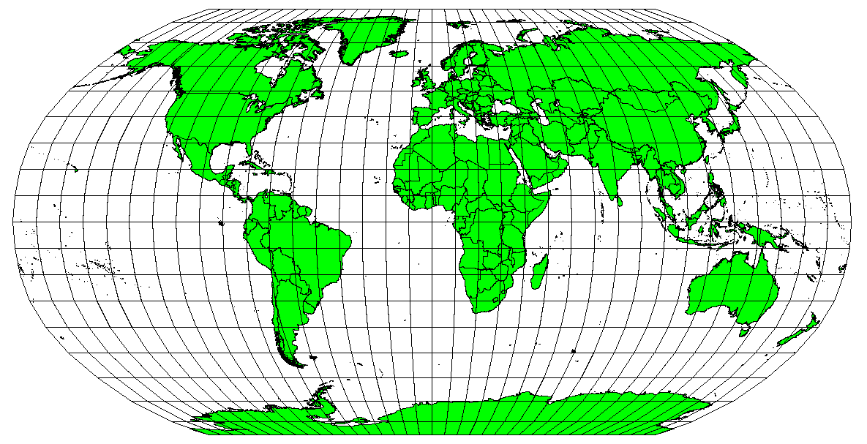
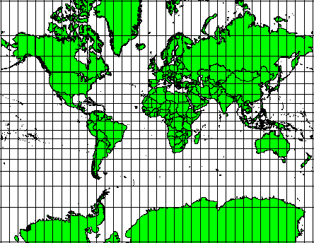
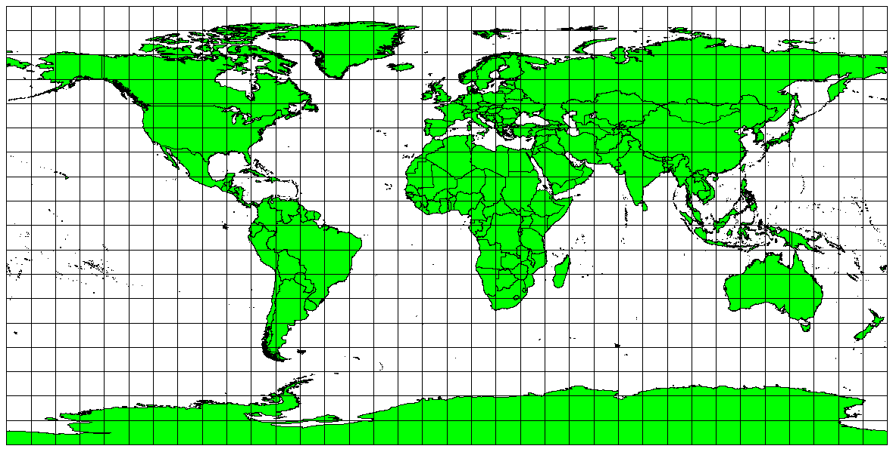
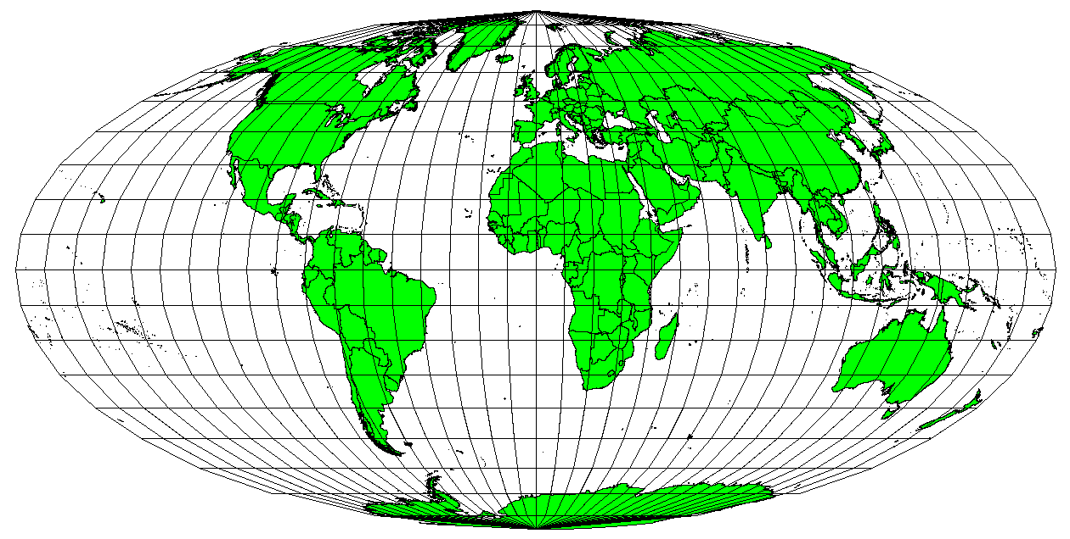
What is Geospatial Data? Projections
Robinson Projection
Mercator Projection
Plate Carree Equidistant Cylindrical Projection
Mollweide Equal Area Cylindrical Projection
Notes:
Robinson projection: pseudocylindrical, area, angular conformity and distance are acceptable
Mercator Projection: cylindrical
Plate Carree Equidistant Cylindrical Projection: equidistant cylindrical projection, scale of the map is kept constant
Mollweide Equal Area Cylindrical Projection: equal area cylindrical projection (constant spacing (for meridional intervals of constant spacing), and circles of latitude to horizontal straight lines of constant spacing (for constant intervals of parallels).

Slide 17
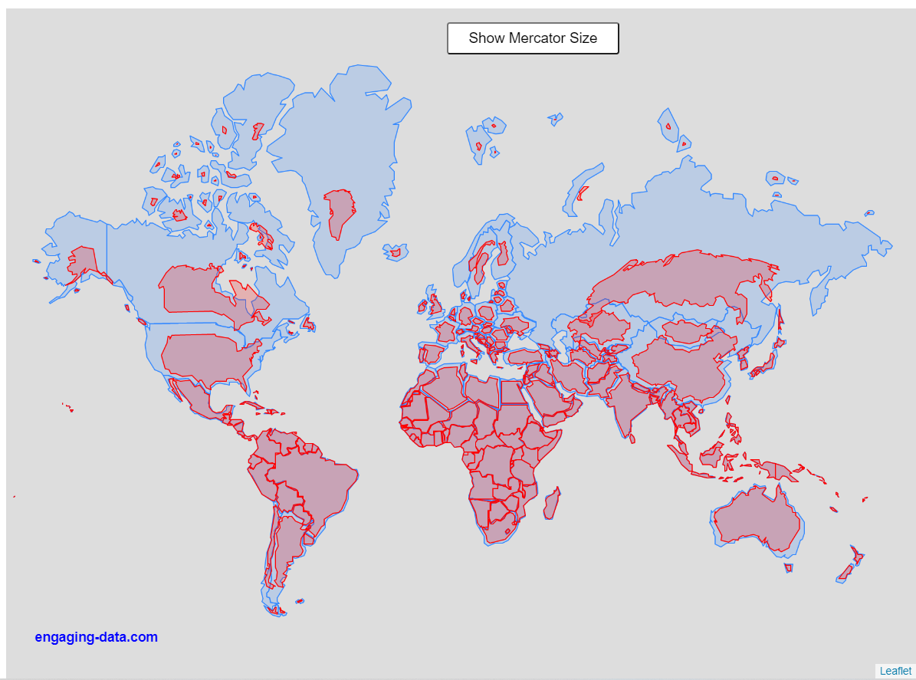
What is Geospatial Data? Projections
A common projection is Mercator
No projections are entirely accurate, they are representations of reality, not reality itself
https://engaging-data.com/country-sizes-mercator/
https://thetruesize.com/#/aboutModal?borders=1~!MTU0MzY5MjU.NTEzMTkzNw*MzIyNDYwNjQ(NTI0NjA2NA

Slide 18
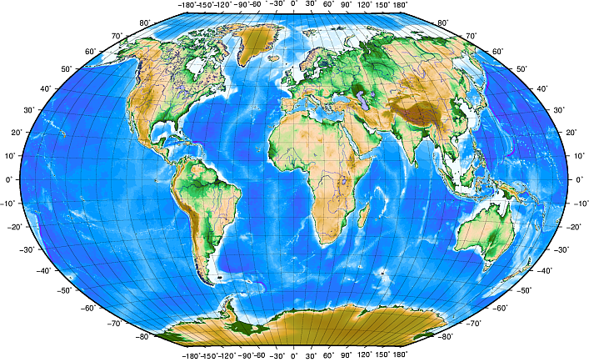
What is Geospatial Data? Coordinate Reference Systems (CRS)
CRS can be divided into two main categories: projected and geographic
Geographic use longitude and latitude (WGS 84 is a common geographic CRS)
https://docs.qgis.org/3.16/en/docs/gentle_gis_introduction/coordinate_reference_systems.html

Slide 19
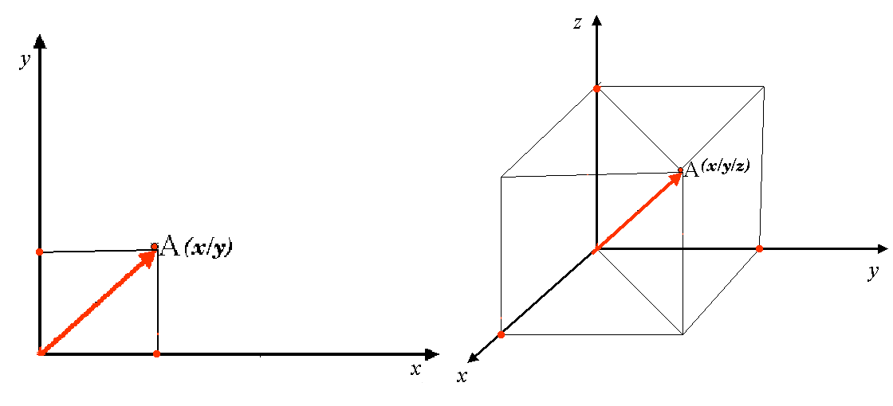
What is Geospatial Data? Coordinate Reference Systems (CRS)
CRS can be divided into two main categories: projected and geographic
Projected use x and y coordinates, and occasionally z for 3 dimensional data
https://www.earthdatascience.org/courses/use-data-open-source-python/intro-vector-data-python/spatial-data-vector-shapefiles/geographic-vs-projected-coordinate-reference-systems-python/

Slide 20
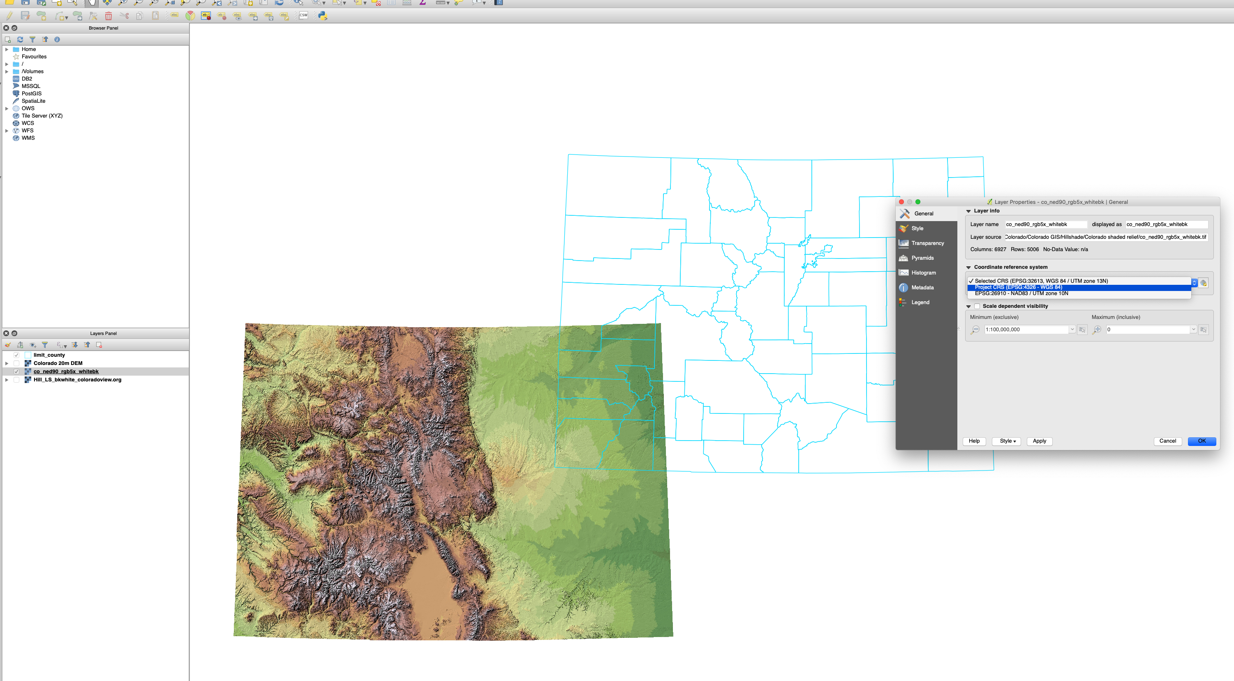
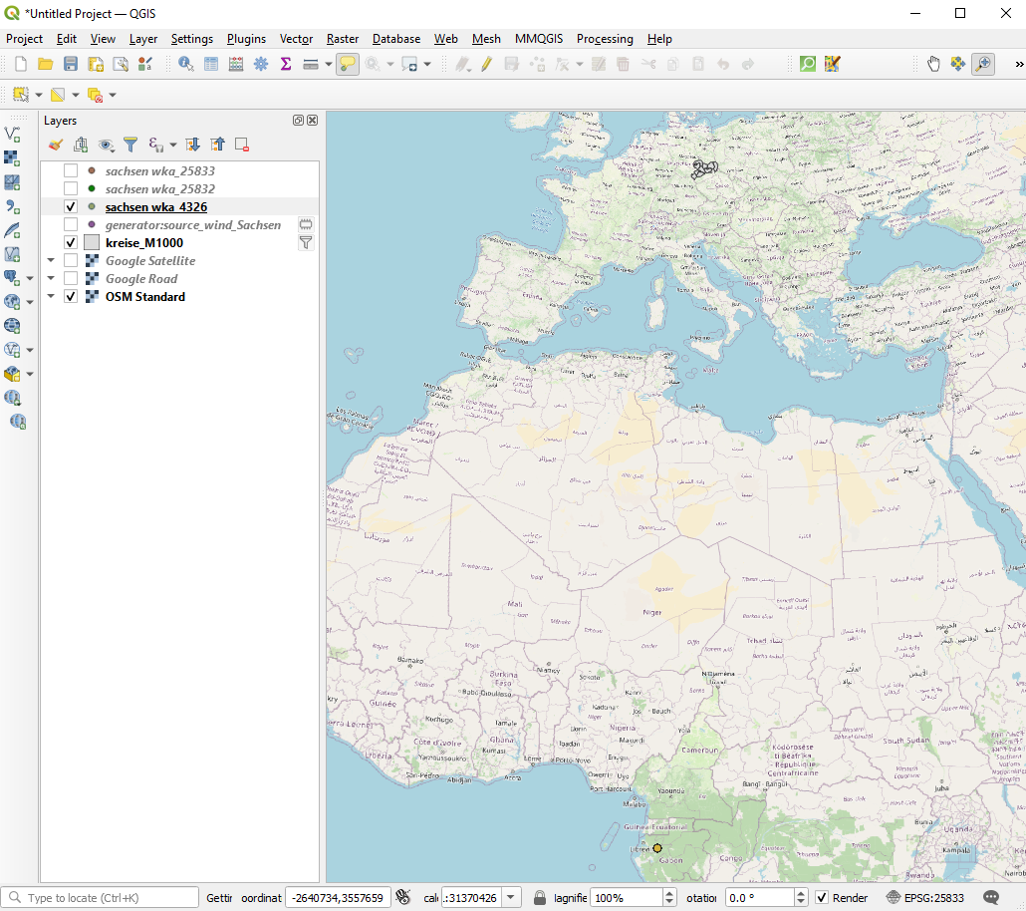
What is Geospatial Data? Issues with neglecting CRS
Most issues in your project will probably originate in problems with CRS.
Always check the CRS of the data you use.

Slide 21
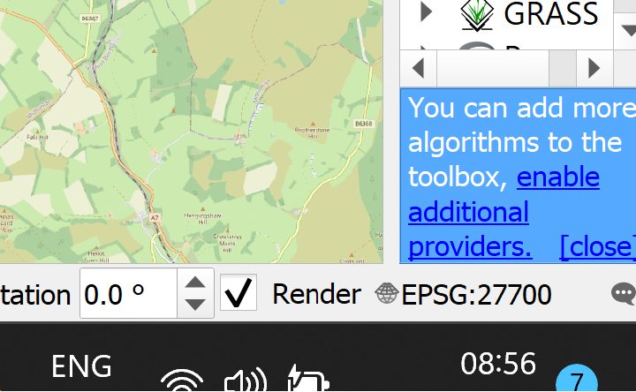
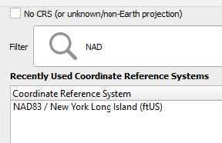
Sounds too conceptual… Let’s go back to QGIS…
Make the projection wrong…
Change the projection to NAD83

Slide 22
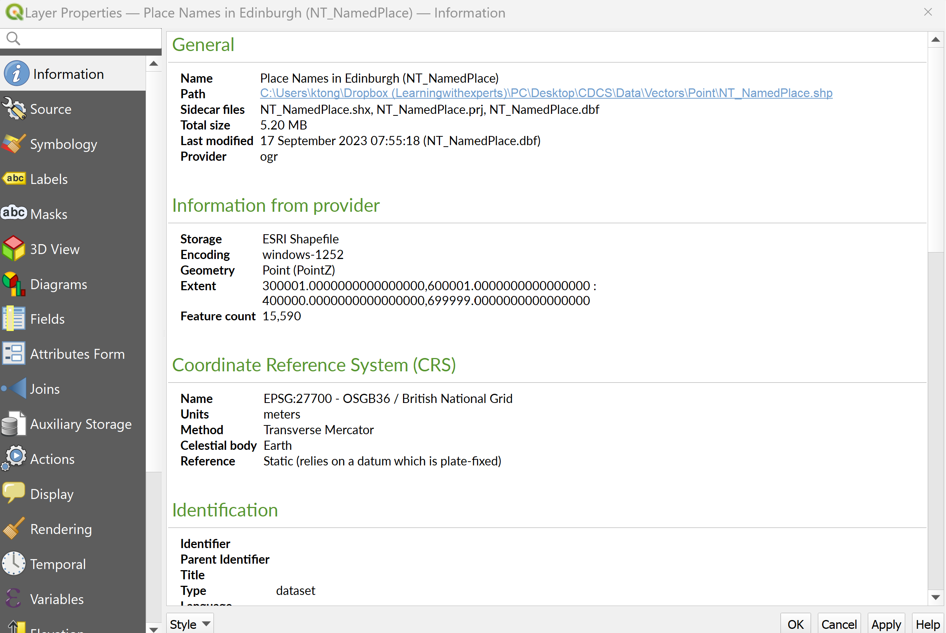
How do I know what CRS the layer uses?
Ask the layer…

Slide 23
So, let’s build the file that you just saw from scratch…
Start a new QGIS project
Import the vector layers (Constits_Data , NT_Road, NT_NamedPlace)
Import the raster layer (Elevation)
Green label when you are done

Slide 24
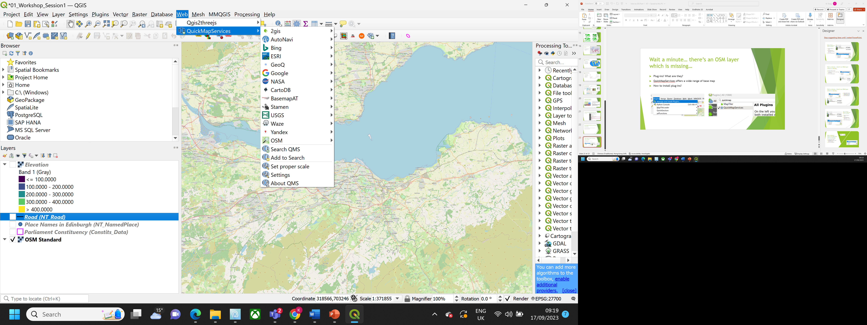
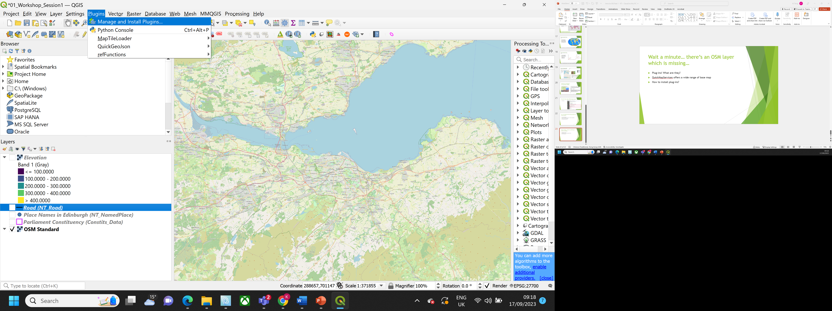
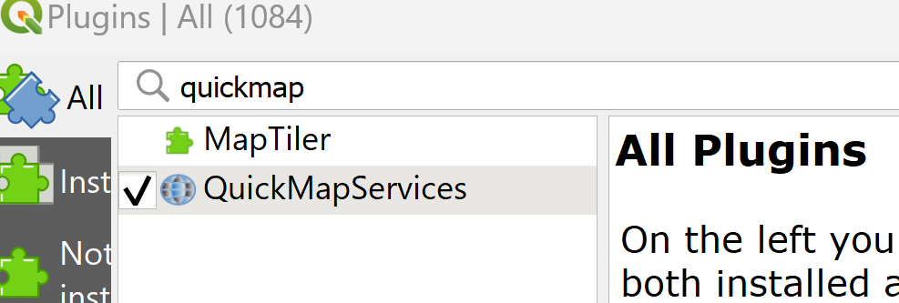
Wait a minute… there’s an OSM layer which is missing…
Plug-ins! What are they?
QuickMapServices offers a wide range of base map
How to install plug-ins?

Slide 25
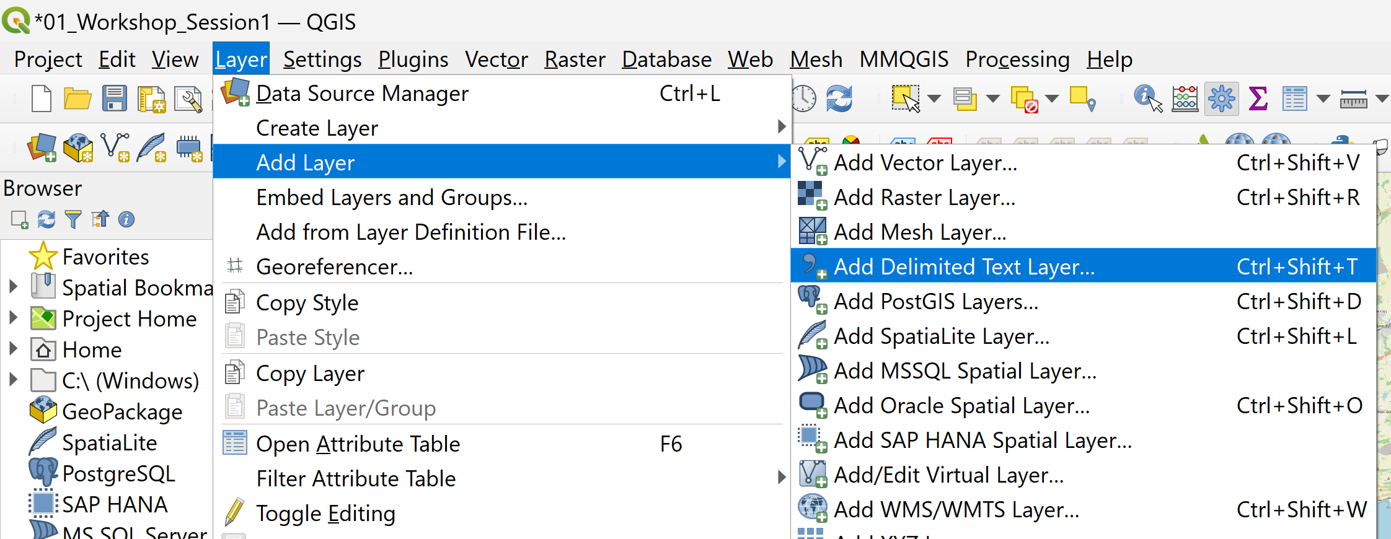
I have a list of coordinates, can I make them spatial?
Yes! You could import CSV into QGIS. Let’s try that.

Slide 26
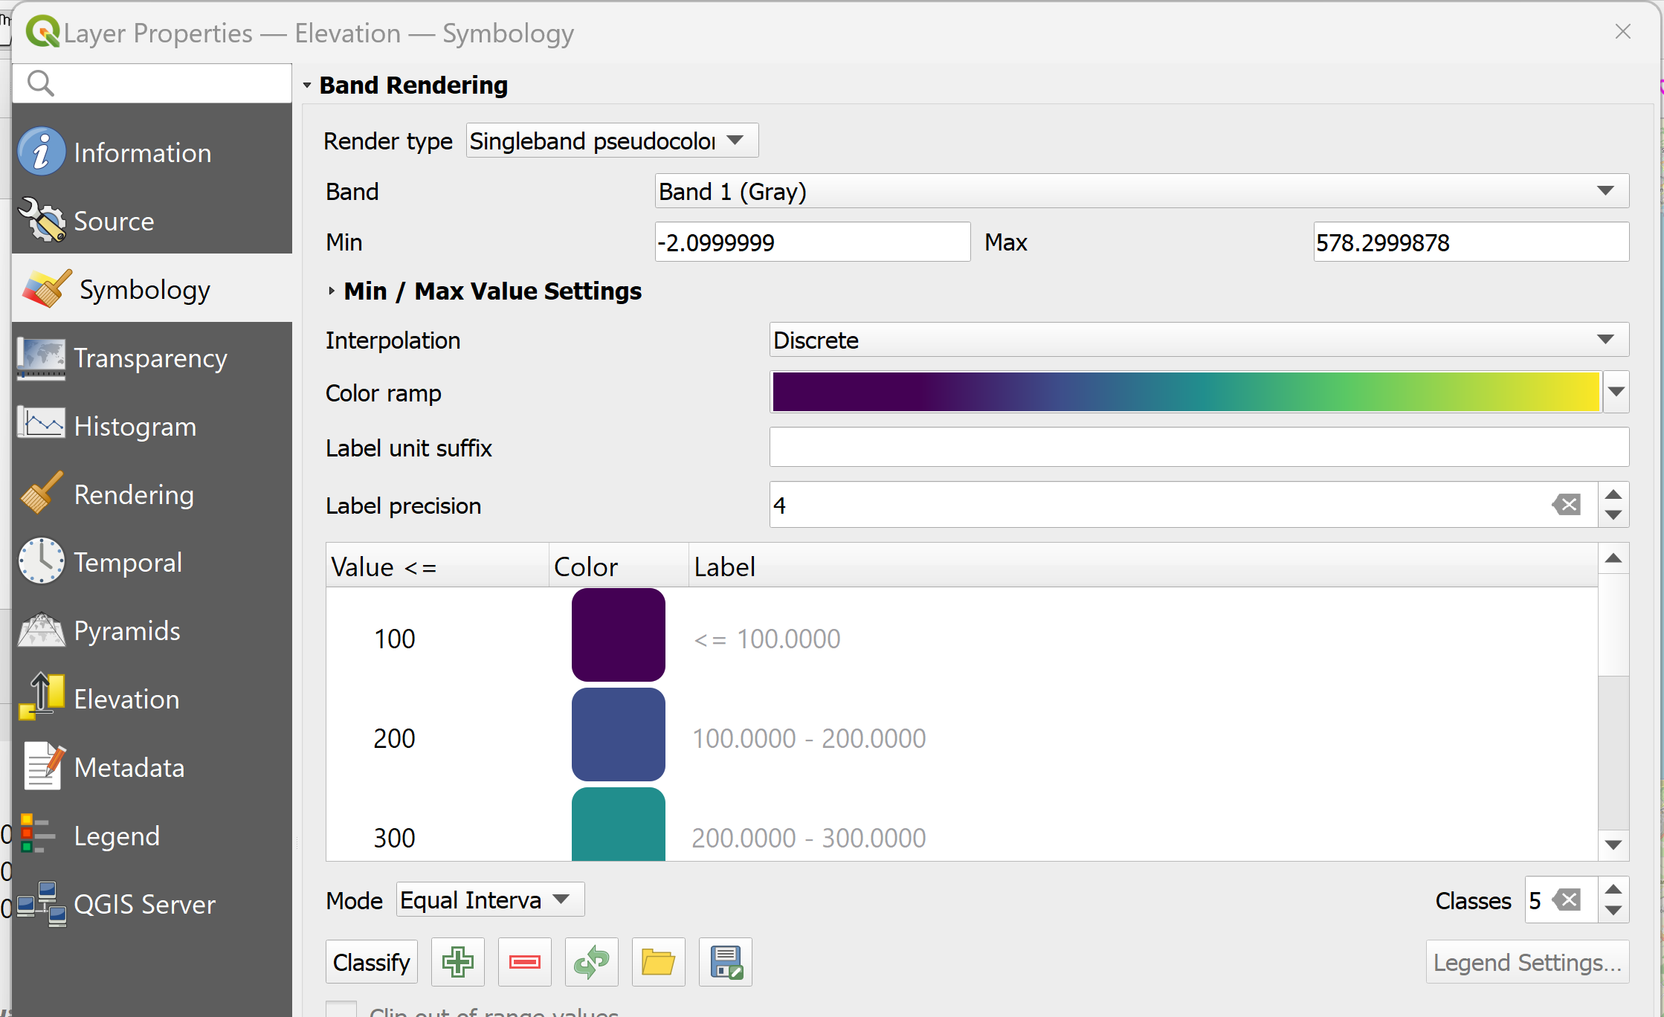
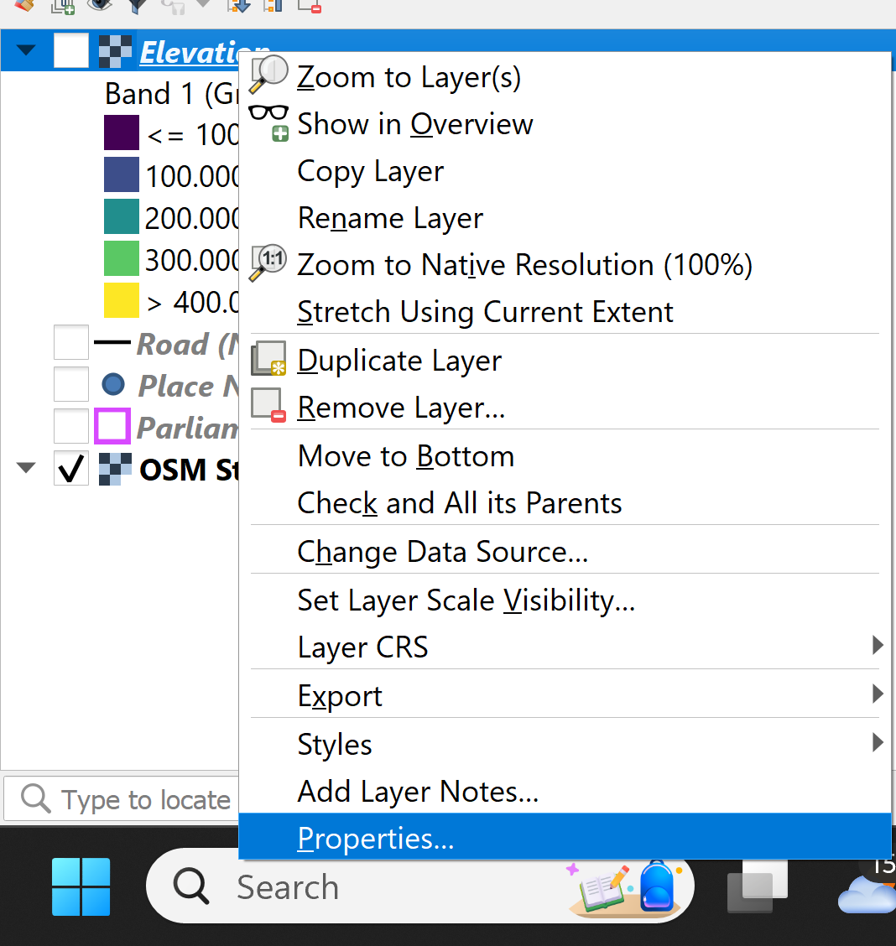
How can I make my map prettier…
Properties→ symbology

Slide 27
Try changing the symbology for vectors Do you notice the difference?

Slide 28
Elevation model is 3D. Can I view model in 3D?

Slide 29
